Slide 1
Introduction to Statistical Methods
ISM TEAM

Slide 2
Course No: AIML ZC418/ DSECT ZC418
Webinar 1 : 26-08-2026

Slide 3
Topics - Webinar
Descriptive Statistics
Measures of Central Tendency
Measures of Variability
Probability
Introduction and Basics
Conditional probability
Total Probability

Slide 4
Measures of Central Tendency
1) A psychologist wrote a computer program to simulate the way a person responds to a standard IQ test. To test the program, he gave the computer 15 different forms of a popular IQ test and computed its IQ from each form.
IQ Values:
134 136 137 138 138 143 144 144 145 146 146 146
147 148 153
Find the following Statistical measures:
i. Mean, median, and mode
ii. Range, Variance and standard deviation
iii. The interquartile range.
iv. Identify potential outliers, if any.
v. Construct and interpret a boxplot

Slide 5
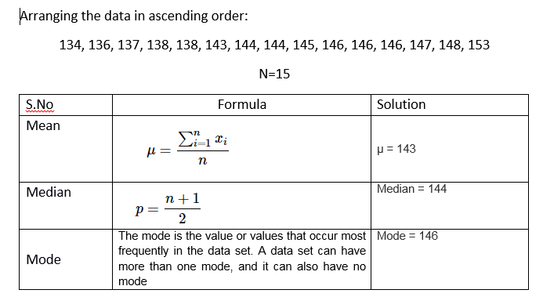
Measures of Central Tendency
Measure

Slide 6
Mode, Bimodal, and Multimodal
A given set of data may have one or more than one Mode. A set of numbers with one Mode is unimodal, a set of numbers having two Modes is bimodal, a set of numbers having three Modes is trimodal, and any set of numbers having four or more than four Modes is known as multimodal.
Bimodal Mode – A set of data including two modes is identified as a bimodal model. This indicates that there are two data values that possess the highest frequencies. For example, the mode of data set B = { 8, 12, 12, 14, 15, 19, 17, 19} is 12 and 19 as both 12 and 19 are repeated twice in the given set.
No mode:
If no number in a set of numbers occurs more than once, that set has no mode: 3, 6, 9, 16, 27, 37, 48.
A unimodal mode is a set of data with only one mode.
A bimodal mode is a set of data that has two modes.
A trimodal mode is a set of data that has three modes.

Slide 7
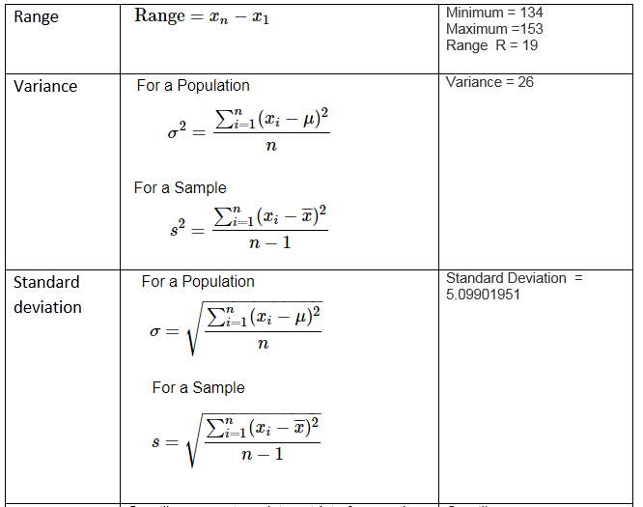
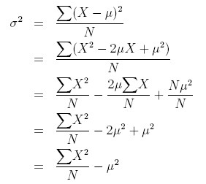
Measures of Variability

Slide 8
Measures of Central Tendency
134 136 137 138 138 143 144 144 145 146 146 146 147 148 153
Minimum.
Q1 (the first quartile, or the 25% mark).
Median.
Q3 (the third quartile, or the 75% mark).
Maximum.

Slide 9
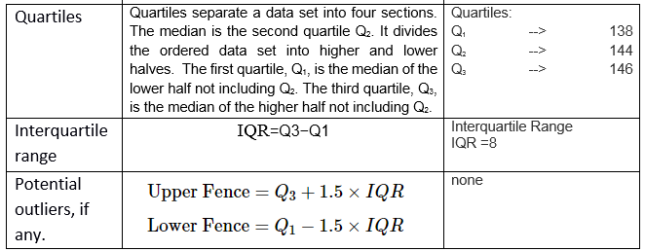
Measures of Central Tendency

Slide 10
Graphical Representation:Box plot
IQR = Q₃ – Q₁
Q₁-1.5 IQR
Q₃+1.5 IQR
Min
Max
Q₁
Q₂
Q₃
Outlier
Outlier

Slide 11
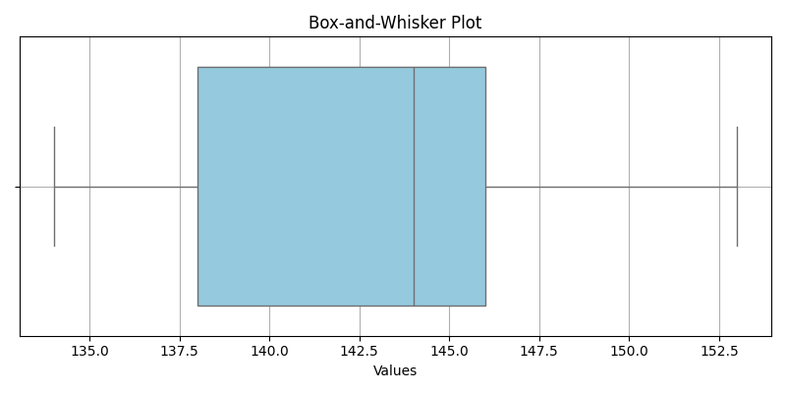
Box-plot for the given data:
Population size: 15 Median: 144 Minimum: 134 Maximum: 153 First quartile: 138 Third quartile: 146 Interquartile Range: 8 Outliers: none

Slide 12
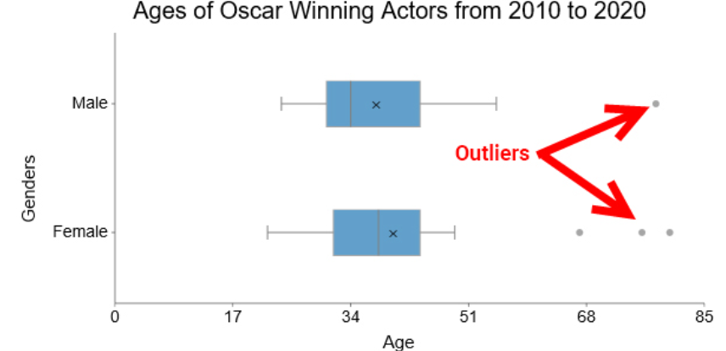
Real-time Example:

Slide 13
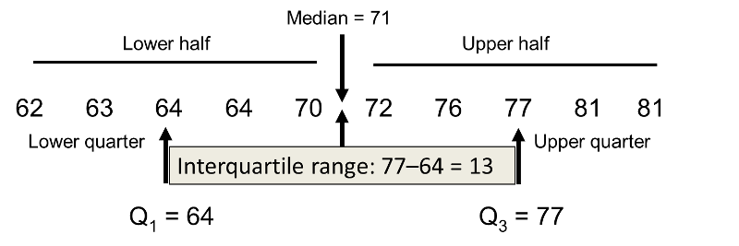
Q1 , Median (Q2) and Q3 ( n is even)

Slide 14
Example:
Data: 5, 7, 8, 9, 10, 12, 13, 15, 18, 30
Five- point summary:
Q1 = 8
Q2 (Median) = 11
Q3 = 15
IQR = 15 - 8 = 7
Lower bound = 8 - (1.5 × 7) = -2.5
Upper bound = 15 + (1.5 × 7) = 25.5
✅ Any value > 25.5 or < -2.5 is an outlier → here, 30 is an outlier.

Slide 15
2)Consider the following statistical summary of a dataset. Write at least three useful observations as a part of data pre – processing. [Midsem Sep’ 2023]
Nr Cells QValue Fat Protein
count 969.000000 969.000000 969.000000 969.000000 969.000000
mean 7.074303 358.284830 90.016584 3.620279 3.300196
std 4.759793 344.324223 4.998924 0.349956 0.136071
min 1.000000 0.000000 62.650000 2.240000 2.750000
25% 3.000000 157.000000 87.570000 3.410000 3.220000
50% 6.000000 283.000000 90.750000 3.610000 3.310000
75% 10.000000 476.000000 93.400000 3.820000 3.380000
max 20.000000 5226.000000 100.000000 5.420000 3.840000

Slide 16
Contd….
Observation 1: The variation in Protein is found very low when compared with remaining using coefficient of variation = sd/mean
Observation 2: The range in Protein is found very low when compared with remaining using range = max-Min
Observation 3: The middle range in Protein is found very low when compared with remaining using quartile range = Q3(75%)-Q1(25%)
Etc…………

Slide 17

Basic Probability
3)

Slide 18
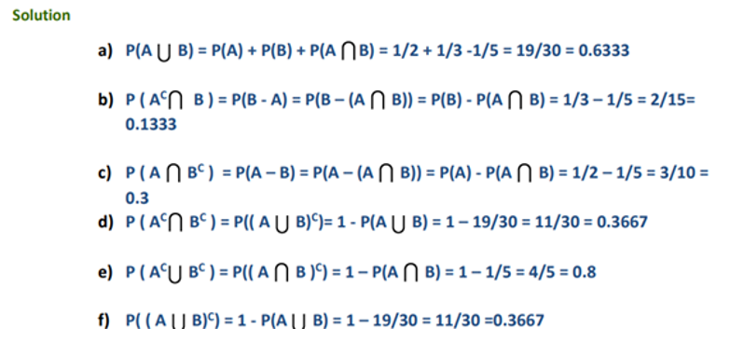

Slide 19
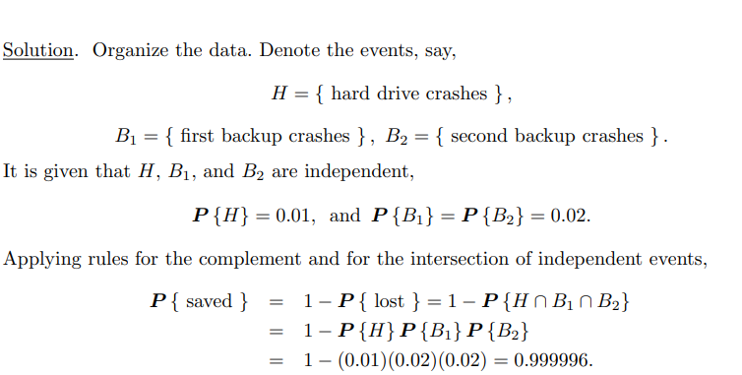
Basic Probability
4) There is a 1% probability for a hard drive to crash. Therefore, it has two backups, each having a 2 % probability to crash, and all three components are independent of each other. The stored information is lost only in an unfortunate situation when all three devices crash. What is the probability that the information is saved?

Slide 20
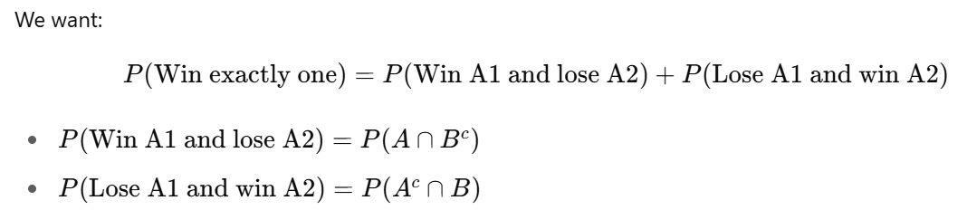
Basic Probability
5)
A political leader has submitted his nomination to compete in two different electoral constituencies namely A1 and A2. The probability of wining in constituency A1 and A2 is 0.80 and 0.65 respectively. The probability of losing at least one of the constituencies is 0.35. What will be the probability that he will win in exactly one of the constituencies?

Slide 21
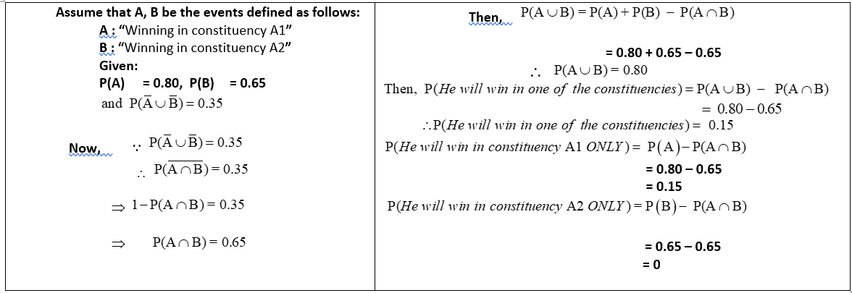
Solution:
A political leader has submitted his nomination to compete in two different electoral constituencies namely A1 and A2. The probability of wining in constituency A1 and A2 is 0.80 and 0.65 respectively. The probability of losing at least one of the constituencies is 0.35. What will be the probability that he will win in one of the constituencies?

Slide 22
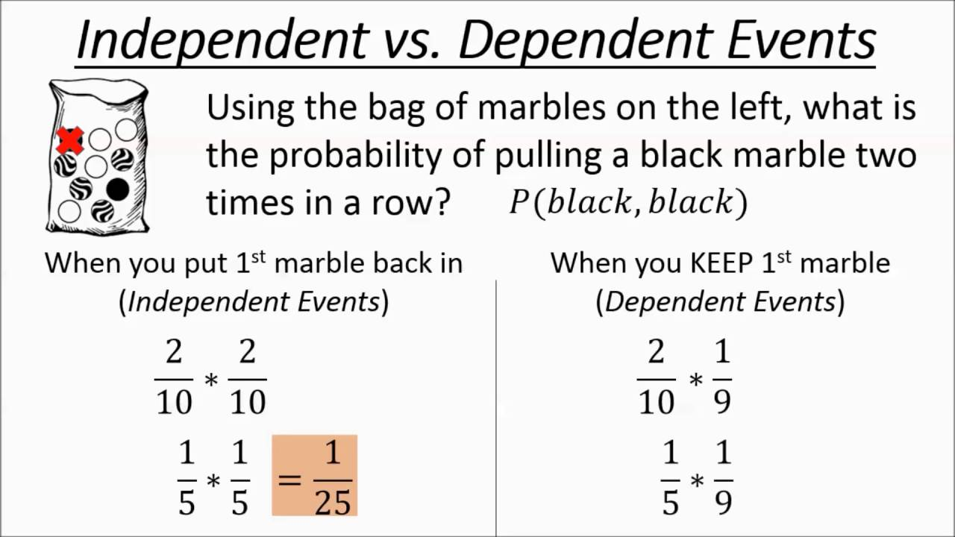
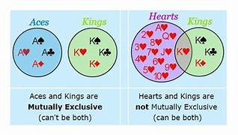

Slide 23
Independent events
6) Comment on the statement:
“If two events are mutually exclusive, then they are independent also and vice versa”

Slide 24
Independent events
7) Let A and B be the two possible outcomes of an experiment and suppose P(A) = 0.4, P(B) = p and P(AUB) = 0.7
(i) For what choice of ‘p’ are A and B mutually exclusive?
(ii) For what choice of ‘p’ are A and B independent?

Slide 25
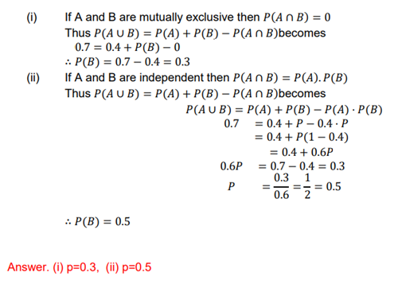
Solution:

Slide 26
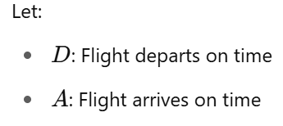
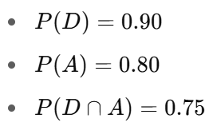
Conditional Probability
8. Ninety percent of flights depart on time. Eighty percent of flights arrive on time. Seventy-five percent of flights depart on time and arrive on time.
a) You are meeting a flight that departed on time. What is the probability that it will arrive on time?
b) You have met a flight, and it arrived on time. What is the probability that it departed on time?
c) Are the events, departing on time and arriving on time, independent?

Slide 27
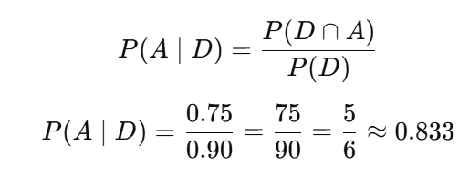
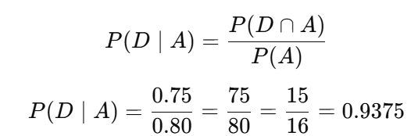
Solution:
a)
b)
You are meeting a flight that departed on time. What is the probability that it will arrive on time?
You have met a flight, and it arrived on time. What is the probability that it departed on time?

Slide 28
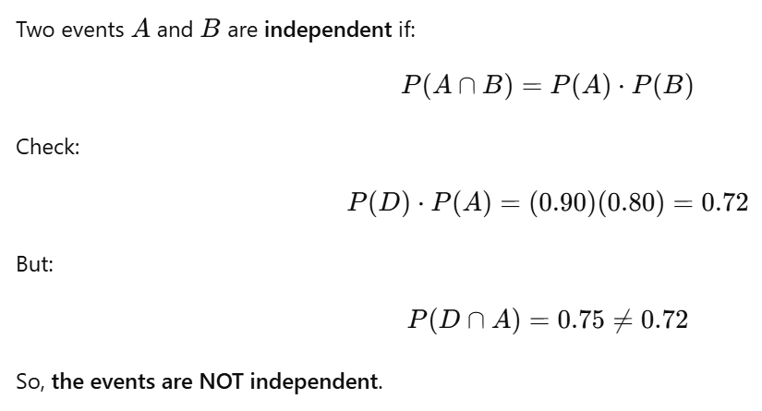
c)
Are the events, departing on time and arriving on time, independent?

Slide 29
Conditional Probability
9) In an online shopping survey, 30% of persons made shopping in Flipkart, 45% of persons made shopping in Amazon
and 5% made purchases in both. If a person is selected at random, find
i) the probability that he makes shopping in at least one of two companies
ii)the probability that he makes shopping in Amazon given that he already made shopping in Flipkart.
iii)the probability that the person will not make shopping in Flipkart given that he already made purchase in Amazon.

Slide 30
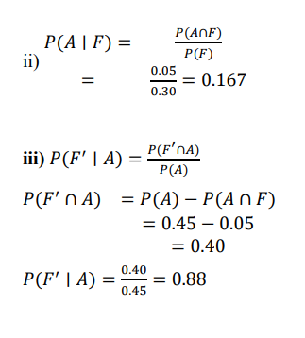
Conditional Probability
Solution: Given 𝑃(𝐹) = 30% = 0.30 𝑃(𝐴) = 45% = 0.45
𝑃(𝐹 ∩ 𝐴) = 5% = 0.05
i) 𝑃(𝐹 ∪ 𝐴) = 𝑃(𝐹) + 𝑃(𝐴) − 𝑃(𝐹 ∩ 𝐴)
= 0.30 + 0.45 − 0.05 = 0.7

Slide 31
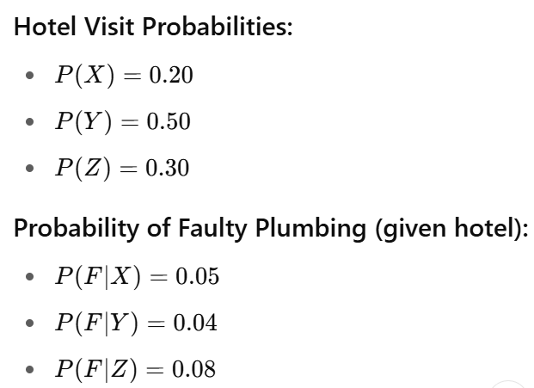
Total Probability
10) A businessman goes to hotels X, Y, Z -20%, 50%, 30% of the time, respectively. It is known that 5%, 4%, 8% of the rooms in X, Y, Z hotels have faulty plumbing. Determine the probability that the businessman goes to hotel with faulty plumbing.
Given:

Slide 32
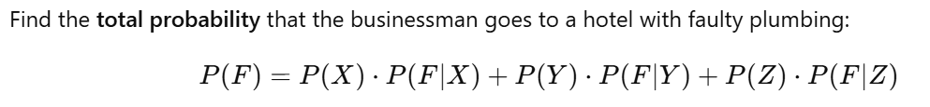
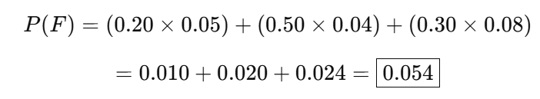

Slide 33
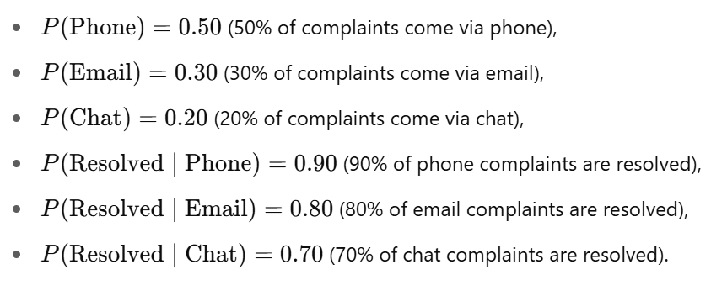
Total Probability
11) A company receives 50% of customer complaints via phone, 30% via email, and 20% via chat. Resolution rates:
Phone: 90%
Email: 80%
Chat: 70%
What is the probability that a randomly selected complaint is resolved?
Given:

Slide 34
Conclusion:
So, there is an 83% chance that a randomly selected customer complaint will be resolved, based on the given resolution rates for each channel.

Slide 35
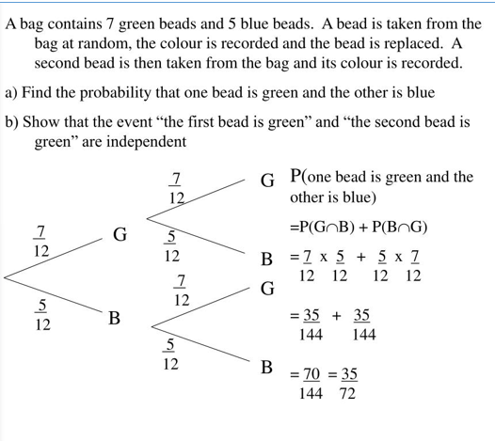
Problem:
12.
Solution:

Slide 36
Problem:
13.
Suppose A, B and C are three mutually exclusive events in a sample space. Given that S= AUBUC, P(A) = (1/5)P(B), and P(C)= 4P(A), find P(BUC).
Solution:

Slide 37
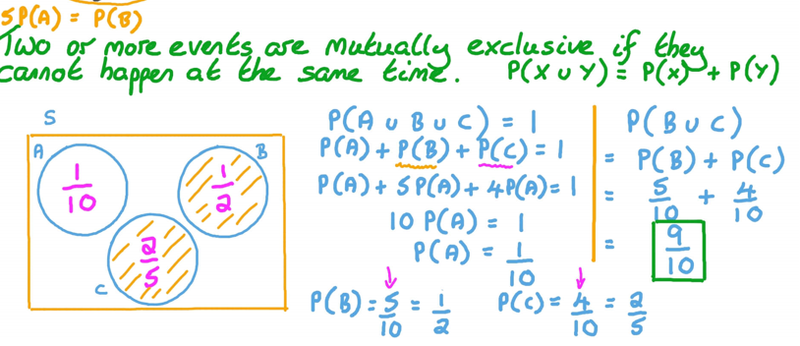
Problem:
13.
Suppose A, B and C are three mutually exclusive events in a sample space. Given that S= AUBUC, P(A) = (1/5)P(B), and P(C)= 4P(A), find P(BUC).
Solution:

Slide 38
Practice Problems
If P (A) =1/3, P (B) =1/2, P (A/B) = 1/6 find i). P(B/A) ii). P(B/A’) iii).P(AUB / A) iv).P(B/A) .
2. Three machines A, B , C produce 50%, 30%, and 20% of the items in a factory. The percentage of defective outputs of these machines are 3, 4 and 5 respectively.
If an item is selected at random, what is the probability that it is defective? (Ans: 0.037)
If a selected item is defective, what is the probability that it is from machine A? (Ans: 0.4054)

Slide 39
Practice Problems
3. A weather app predicts rain with 90% accuracy when it actually rains. It wrongly predicts rain 10% of the time when it doesn't rain. Suppose it rains only 10% of days in a year. You check the app and it predicts rain.
What is the probability it will actually rain? (Ans: 0.5)
4. Consider the following data related to the employees, who are on travel. 40% check work email, 20% use cell phone to stay connected to work, 25% bring laptop with them, 23% check both work email and use cell phone to stay connected, and 50% neither check work email nor use a cell phone to stay connected nor bring a laptop. In addition, 88 out of every 100 who bring a laptop also check work email, and 70 out of every 100 who use a cell phone to stay connected also bring a laptop.
i) What is the probability that a randomly selected traveller who checks work email also uses a cell phone to stay connected?
ii) What is the probability that someone who brings a laptop on vacation also uses a cell phone to stay connected?
iii) If the randomly selected traveller checked work email and brought a laptop, what is the probability that he/she uses a cell phone to stay connected?

Slide 40

Questions please…

Slide 41
THANK YOU!

